Slide 1
The circulatory system
Year 11 Biology
Bremer SHS

Slide 2
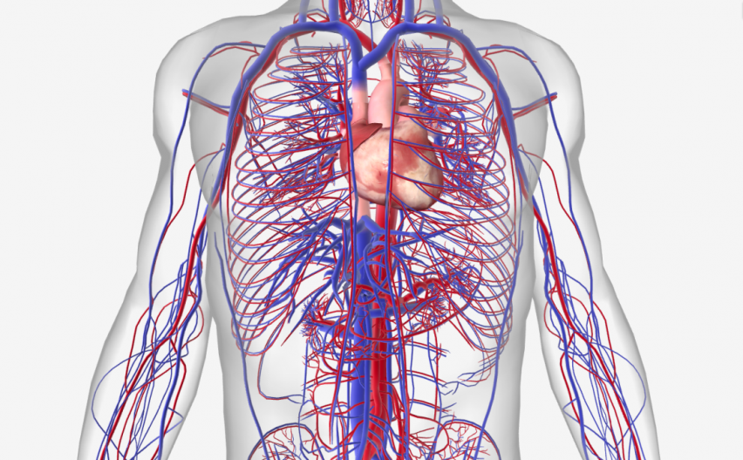
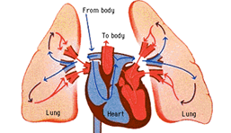
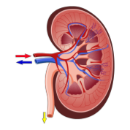
The role of the circulatory system
Transports glucose, oxygen, amino acids, fatty acids, vitamins and minerals to every cell in the body via blood.
Removes wastes from each cell, for excretion in kidneys or lungs.
Interconnects all other systems of the body (eg. digestive, respiratory and excretory systems).
Components of the circulatory system are the heart, veins, arteries, venules, arterioles, capillaries and blood.
Kidney

Slide 3
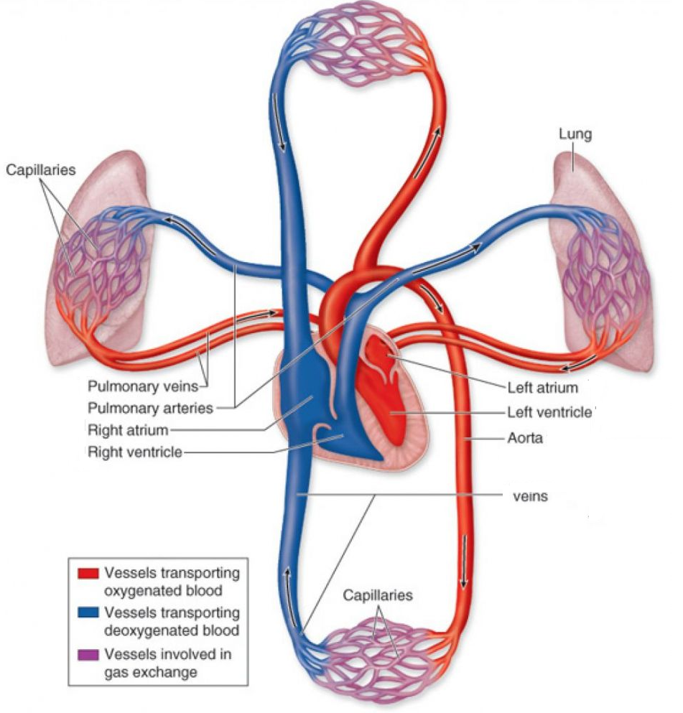
The mammalian heart
Use the diagram to write a statement detailing the journey that blood takes through the circulatory system of a mammal.
Use the aorta as the starting point for your statement.
Your statement should include:
Names of all chambers of the heart (right atrium, right ventricle, left atrium and left ventricle)
Names of any blood carrying vessels
Whether the blood is oxygenated or deoxygenated.

Slide 4
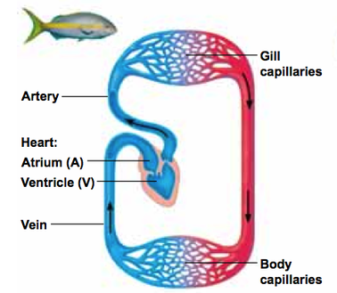
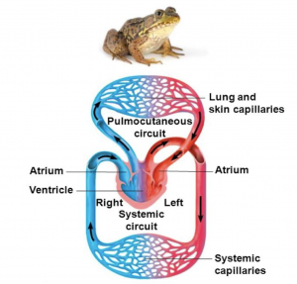
Chambers of The heart
Hearts can have a different number of chambers, depending on the organism.
Fish (inc. sharks) have two chambered hearts
1 atrium and 1 ventricle, simple circulatory system
Amphibians and most reptiles have three chambered hearts
2 atria and 1 ventricle, oxygenated and deoxygenated blood mixes, system in “figure 8”; blood travels from lungs and back to heart before going to the rest of the body.
Birds, mammals & crocodiles have 4 chambered hearts
2 atria and 2 ventricles, oxygenated and deoxygenated blood doesn’t mix, system in “figure 8”; blood travels from lungs and back to heart before going to the rest of the body

Slide 5
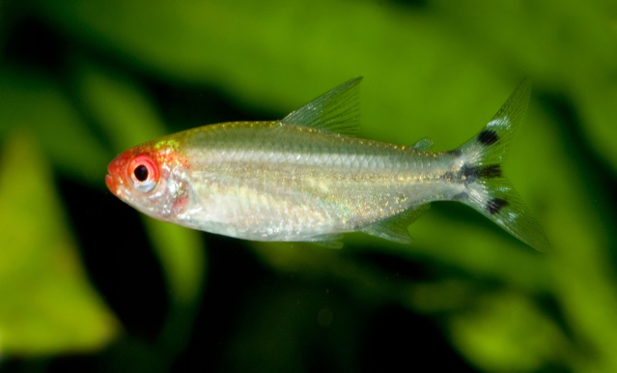

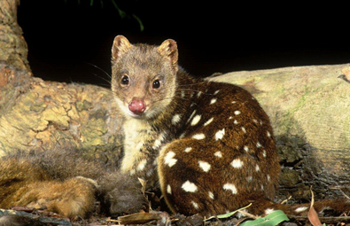
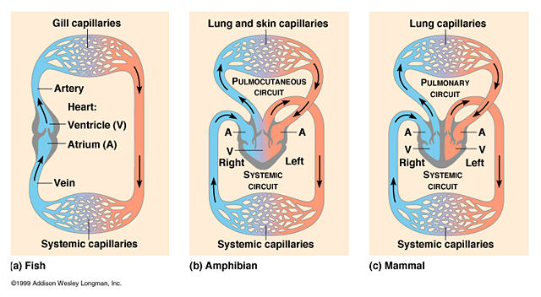

Slide 6
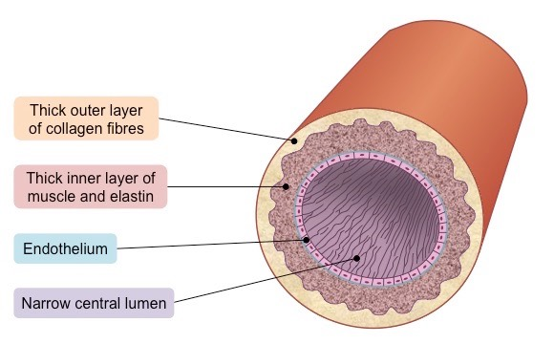
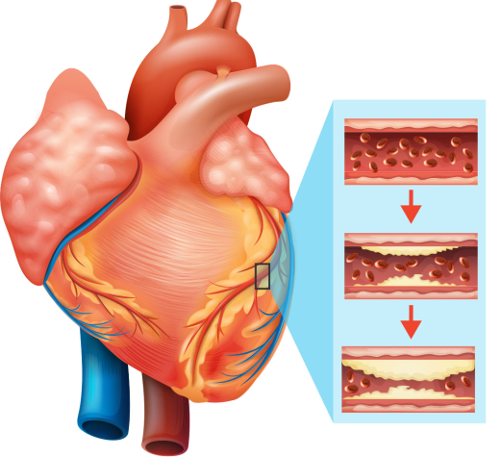
arteries
Arteries carry oxygenated blood away from the heart to the tissues in the body. The exception to this are the pulmonary arteries, which carry blood to the lungs for oxygenation.
Arteries have a higher blood pressure than other parts of the circulatory system. It is highest when the heart contracts and lowest when heart relaxes. The variation in pressure produces a pulse.
The walls of arteries are thick an muscular because they must withstand a much higher blood pressure than veins.
Arteries do not have valves as the blood pressure is very high and backflow is not an issue in this part of the circulatory system.
Structure of an Artery
Plaque build up (fat, cholesterol and calcium) in the coronary artery causes heart disease and is the leading cause of death in Australia.

Slide 7
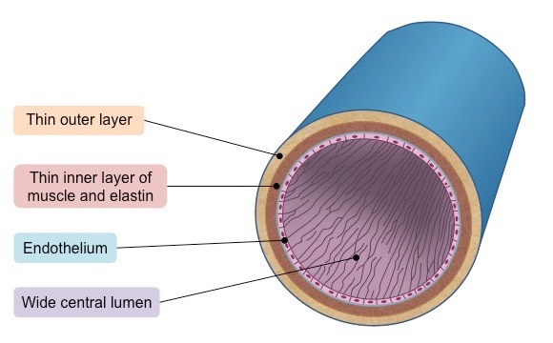
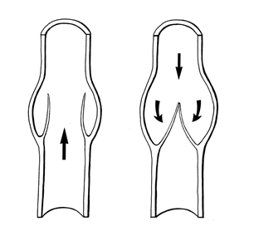
veins
Veins are blood vessels that carry blood toward the heart.
Most veins carry deoxygenated blood from the tissues back to the heart; exceptions are the pulmonary and umbilical veins, both of which carry oxygenated blood to the heart.
Veins are less muscular than arteries because they do not have to withstand high blood pressure and they are often closer to the skin than arteries.
Lower blood pressure often results in backwards blood flow through veins. There are valves in most veins to prevent backflow of blood.
Structure of a Vein
Valves in veins help blood to flow in the right direction and this, along with muscle movements, help blood return to the heart.

Slide 8
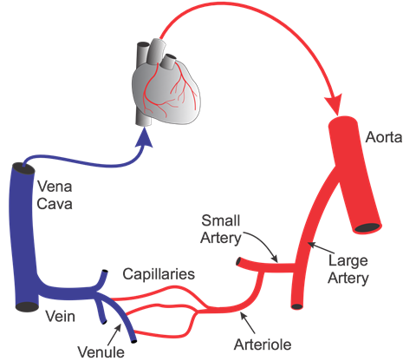
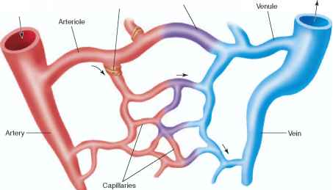
Arterioles and venules
Arteries transport blood away from the heart and branch into smaller vessels, forming arterioles.
Capillaries lead back to small vessels known as venules that flow into the larger veins and eventually back to the heart.
Arterioles and venules act as intermediate connections between arteries and veins to the capillaries.

Slide 9
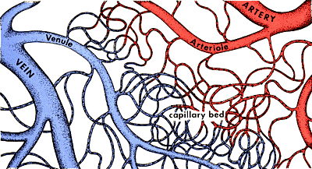
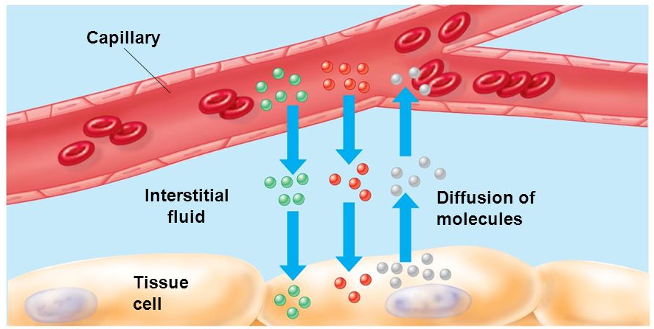
Capillaries
The capillaries are the smallest of the blood vessels with a width of a single cell in diameter to aid in the fast and easy diffusion of gases, sugars and nutrients to surrounding tissues.
Capillaries provide a large surface area for the exchange of gases and nutrients.
Diffusion across capillaries is diverse:
In the lungs: carbon dioxide is exchanged for oxygen
In the tissues: oxygen, carbon dioxide, nutrients, and wastes are exchanged
In the kidneys: wastes are released to be eliminated from the body
In the intestine: nutrients are picked up, and wastes released

Slide 10
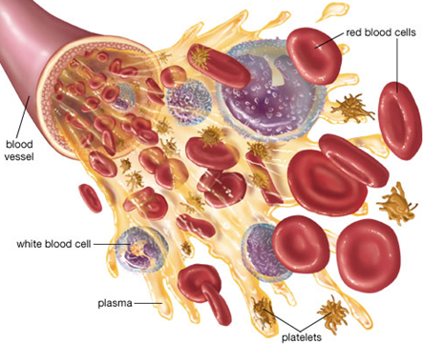
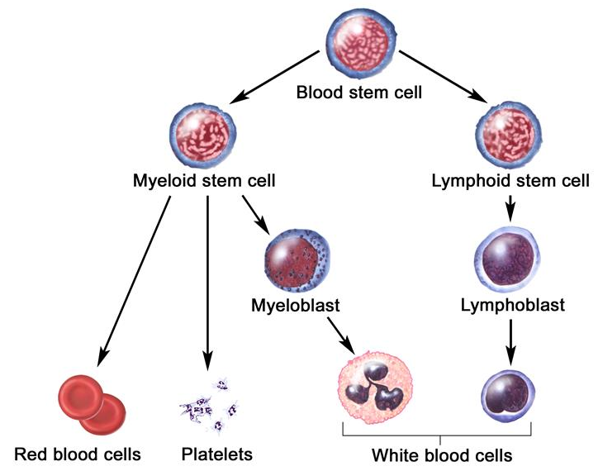
Contents of blood
Blood is comprised of:
Red blood cells that carry oxygen and carbon dioxide
White blood cells are immune cells that identify and remove foreign bodies
Platelets clot blood and form scabs
Plasma is a liquid that carries dissolved nutrients & heat
All parts of blood are made by stem cells in bone marrow

Slide 11
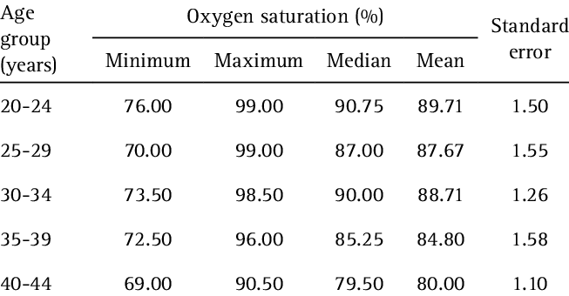
Check for understanding
Use the data presented in Table 1 to answer the following questions.
Describe the trend in mean oxygen saturation.
Outline what the trend in mean oxygen saturation indicates in terms of oxygen requirements for different age groups.
Calculate the range in oxygen saturation values for each age group.
Describe the trend in standard error.
Outline what the trend in standard error indicates in terms of variation in data for different age groups.
Table 1 – Blood oxygen saturation for varying age groups
Hints:
When describing a trend you should outline any patterns/relationships in data and quote data to support your statement.
Range = maximum-minimum

Slide 12
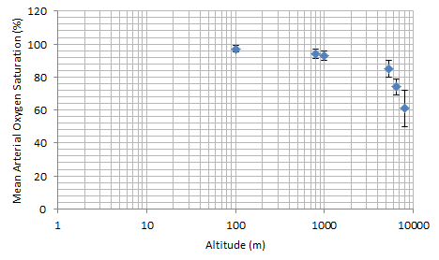
Check for understanding
Use the data presented in Figure 1 and Table 2 to answer the following questions.
Describe the trend in mean oxygen saturation.
Explain what the trend in mean oxygen saturation indicates in terms of oxygen saturation at different altitudes.
Outline the trend in the number of participants for the experiment as altitude increases.
Describe the trend in standard error using the error bars on figure 1.
Outline what the trend in standard error indicates in terms of variation in data.
Suggest a reason why the trend in standard error may have occurred.
Figure 1 – Mean Arterial Oxygen Saturation at Different Altitudes
Table 2: Number of subjects tested at each altitude
Altitude (m) | 0 | 100 | 800 | 1000 | 5400 | 6400 | 8000
Number of Subjects | 20 | 10 | 10 | 10 | 5 | 5 | 2

